Slide 1
CS 634 - Data Mining
Final Term PAPER
Topic : Large-scale Image and Video Classiﬁcation
With Convolutional
Neural Networks
To: Dr. Jason T.L. Wang, Professor
Department of Computer Science
New Jersey Institute of Technology
Done By: Charanpreet Kaur Dhir
UCID: 31478357
ckd22 @njit.edu

Slide 2
Index
Introduction to CNN
Layers of CNN
Definition of CNN layer
Steps CNN work on 2D images
Input Layer
Hidden Layer
Output Layer
How Layers in Convolutional Neural Network Work ?
How Convolutional Layer works?
How ReL U Layer Work?
How Pooling Layer Work
Flattening
Fully Connected Layer
Summary for Image Recognition
Video Recognition

Slide 3
Index
Time information fusion in CNN
Single - framed
Early fusion
Late fusion
Slow fusion
Multi-resolution CNN Architecture
Experiment on Sports - 1M
Dataset
Video Level Predictions
Feature Histogram Baseline
Quantitative Analysis
Contribution to motion
Qualitative Analysis
Result
Conclusion
References

Slide 4
Introduction of CNN
Artificial Neural Networks are used in various classification task like image, audio, words. Different types of Neural Networks are used for different purposes.
A convolutional neural network (CNN) is a type of artificial neural network used in image recognition and processing that is specifically designed to process pixel data.
Convolutional Neural Networks (CNNs) have been established as a powerful class of models for image recognition problems.
A CNN uses a system much like a multilayer perceptron that has been designed for reduced processing requirements. The layers of a CNN consist of an input layer, an output layer and a hidden layer that includes multiple convolutional layers, pooling layers, fully connected layers and normalization layers. The removal of limitations and increase in efficiency for image processing results in a system that is far more effective, simpler to trains limited for image processing and natural language processing.

Slide 5
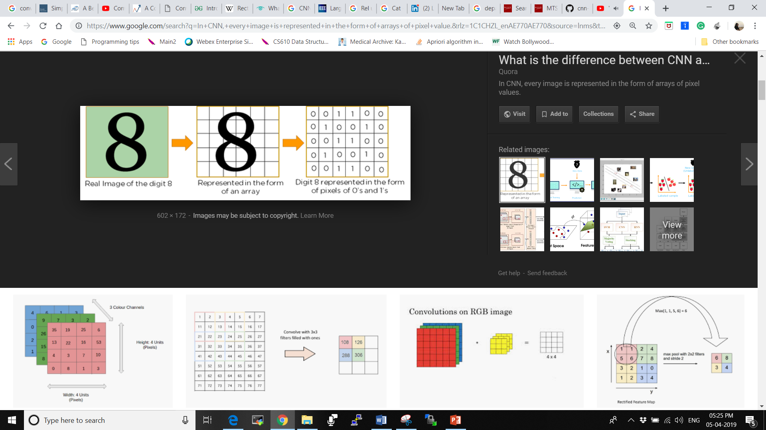
Definition Of Convolutional Neural Network
CNN is a feed forward neural network that is generally used to analyze visual images by processing data with grid like topology. A CNN is also known as a “ConvNet”.
We need to trained the machine so that it can recognize what the image is.
In CNN, every image is represented in the form of arrays of pixel value.
In below fig, the right most part is the representation form , in middle it is converted into pixel value. 1 is for the black part and 0 for white Part

Slide 6
Layers of CNN : As mentioned in previous point about the layers of CNN. In a regular Neural Network there are three types of layers: Input Layers: In this layer we give input to our model. Number of Neurons in this layer = Total number of features in our data. By number of features we mean number of pixels in case of an image. Hidden Layer: The input from Input layer is then feed into the hidden layer. There can be many hidden layers depending upon our model and data size. In Case of CNN we have 3 Hidden layers namely multiple convolutional layers and ReL U (Rectified Linear Units) layers and pooling layers. Each hidden layers can have different numbers of neurons which are generally greater than the number of features. The output from each layer is computed by matrix multiplication of output of the previous layer with learnable weights of that layer and then by addition of learnable biases followed by activation function which makes the network nonlinear. Output Layer: The output from the hidden layer is then fed into a logistic function like sigmoid or softmax which converts the output of each class into probability score of each class.

Slide 7
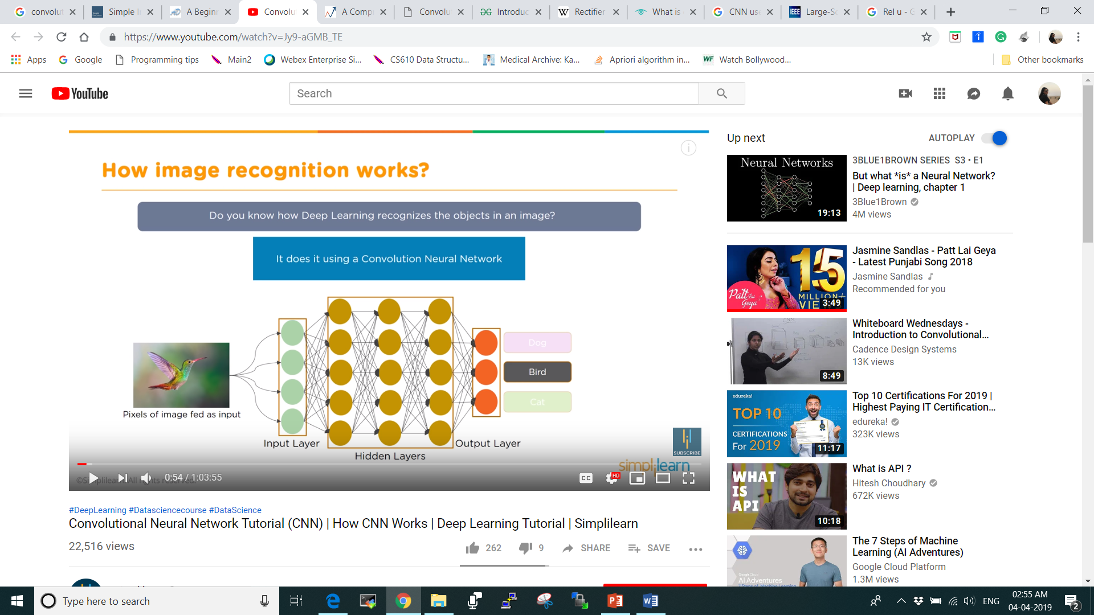


Example : Deep learning recognizes the object in an image using CNN. If we have a picture of humming bird pixels of an image fed as input you have input layer coming in. Output layer recognizes what the image is all about. It takes the input as array of pixels
DOG
CAT
BIRD

Slide 8
Steps CNN work on 2-D image :
Input layer
It accepts the pixels of the image as input in the form of arrays
12 | 19 | 21 | 7 | 40 | 2
60 | 45 | 52 | 10 | 89 | 23
13 | 6 | 50 | 70 | 0 | 33
30 | 11 | 35 | 75 | 15 | 4

Slide 9
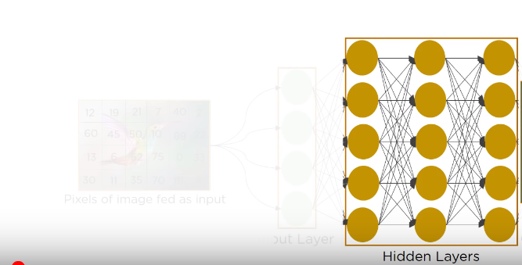
2. Hidden Layer
Hidden Layer Carries out feature extraction by performing certain calculations and Manipulations.
This is a part that reorganizes the picture in multiple ways till we get some data that is easy to read for Neural Network. This layer uses the matrix filter and perform convolutional operation to detect operation.
There are multiple hidden layers like Convolutional Layer, ReL U layer, Pooling layer etc. that perform feature extraction from the image.

Slide 10
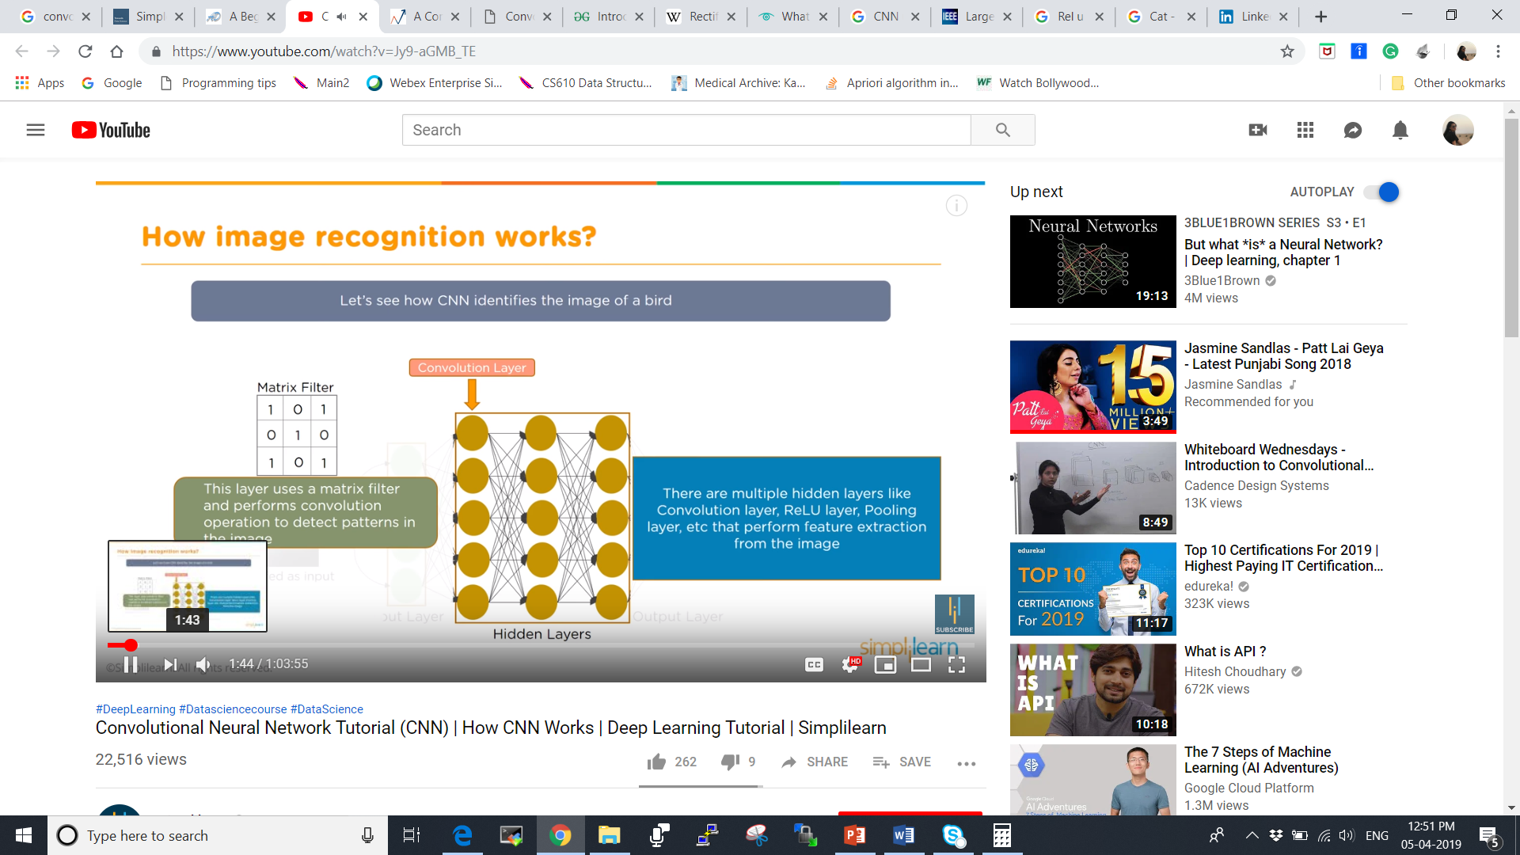
2. a. Convolutional Layer
This layer uses a matrix filter and performs convolutional operation to detect patterns in the image.
Convolutional means to coil or to twist. In this we will twist data around and alter it and use that operation to detect a new pattern.

Slide 11
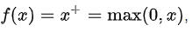
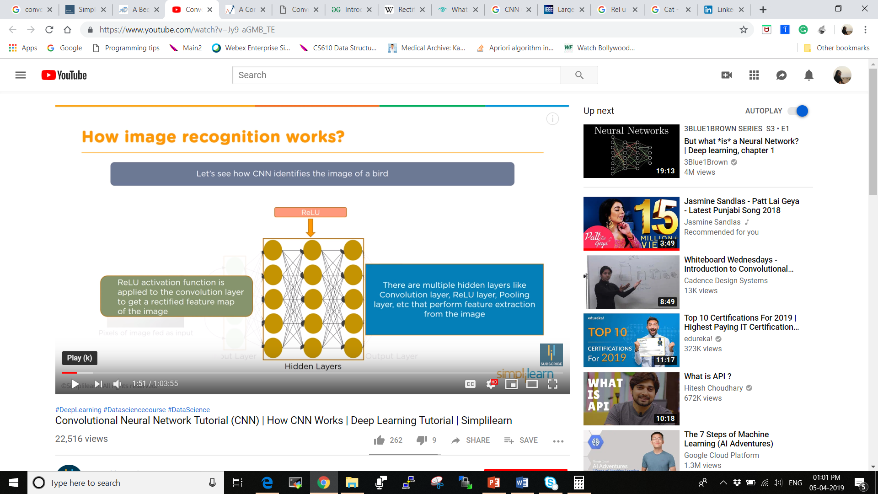
2. b. ReL U (Rectified Linear Unit)
ReL U activation function is applied to the convolutional layer to get a rectified feature map of the image.
The rectifier is an Activation function defined as the positive part of its argument:
where x is the input to a neuron.

Slide 12
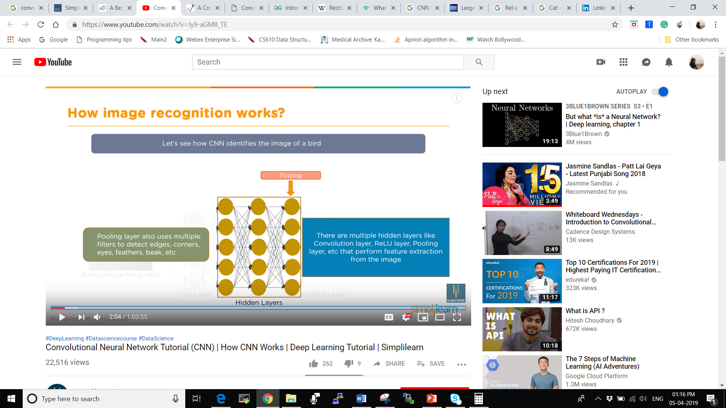
2. c. Pooling
Pooling layer also uses multiple filters to detect edges, corners, eyes, feathers, beak, ears, paws etc.
This layer is periodically inserted in the covnets and its main function is to reduce the size of volume which makes the computation fast reduces memory and also prevents from overfitting.
Pooling is to pulling information together onto what a lot in to closer view. Reducing like mapping and reducing.

Slide 13
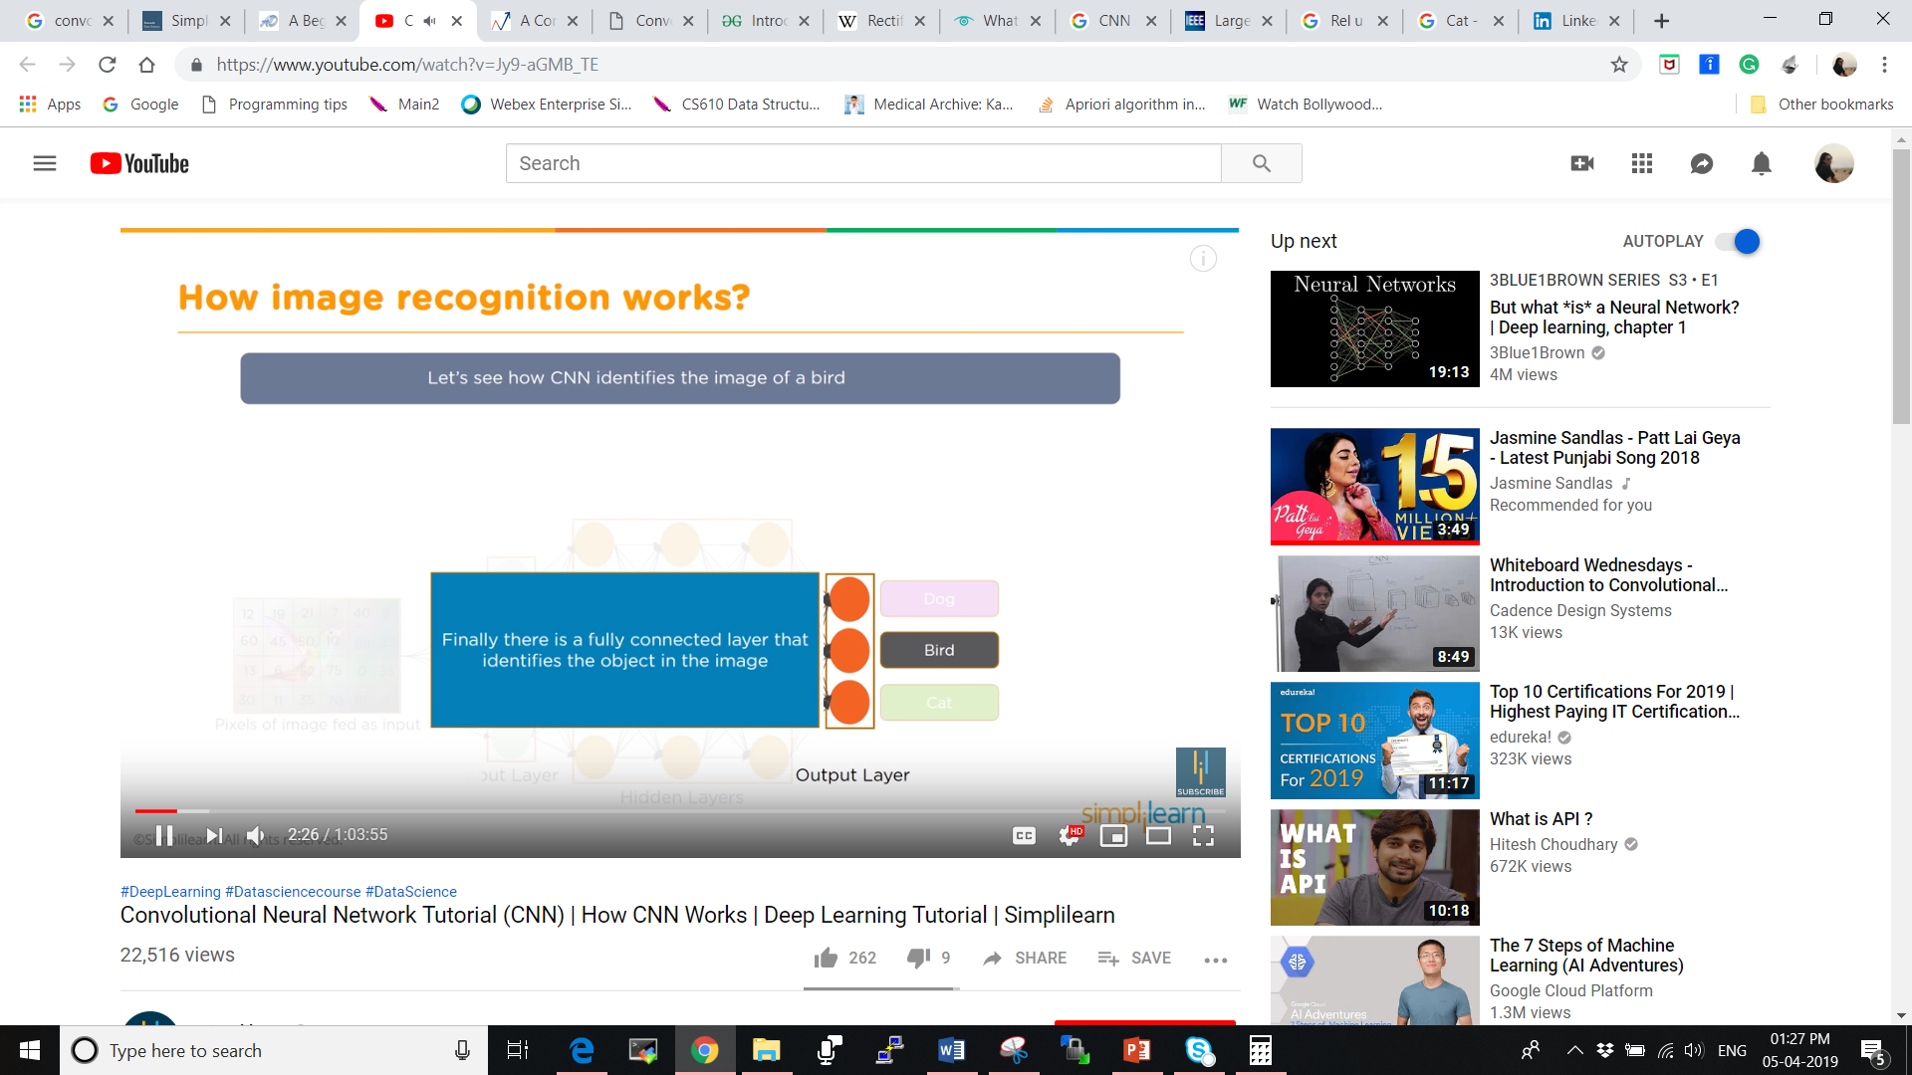
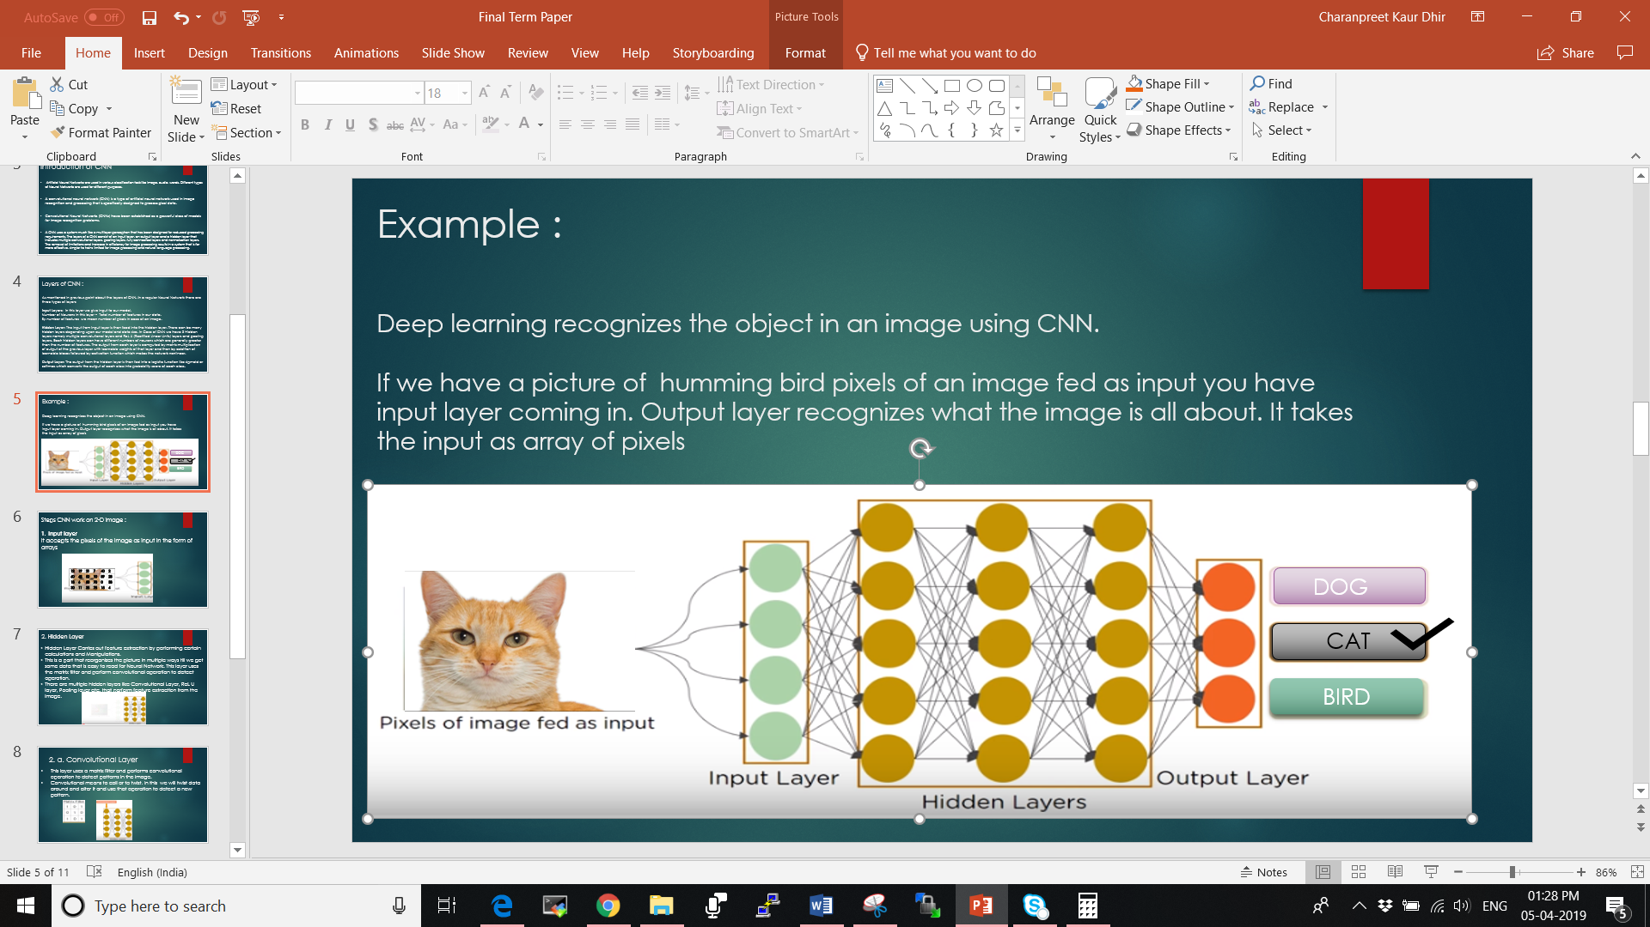
3. Output Layer (Fully Connected Layer)
Fully Connected layer identifies the object in the image.
At the output of the hidden layers we have moved from high resolution, low level data about the pixels to representations of objects within the image. The purpose of these final, fully connected layers is to make classifications regarding these objects – in other words, we bolt a standard neural network classifier onto the end of a trained object detector.

Slide 14
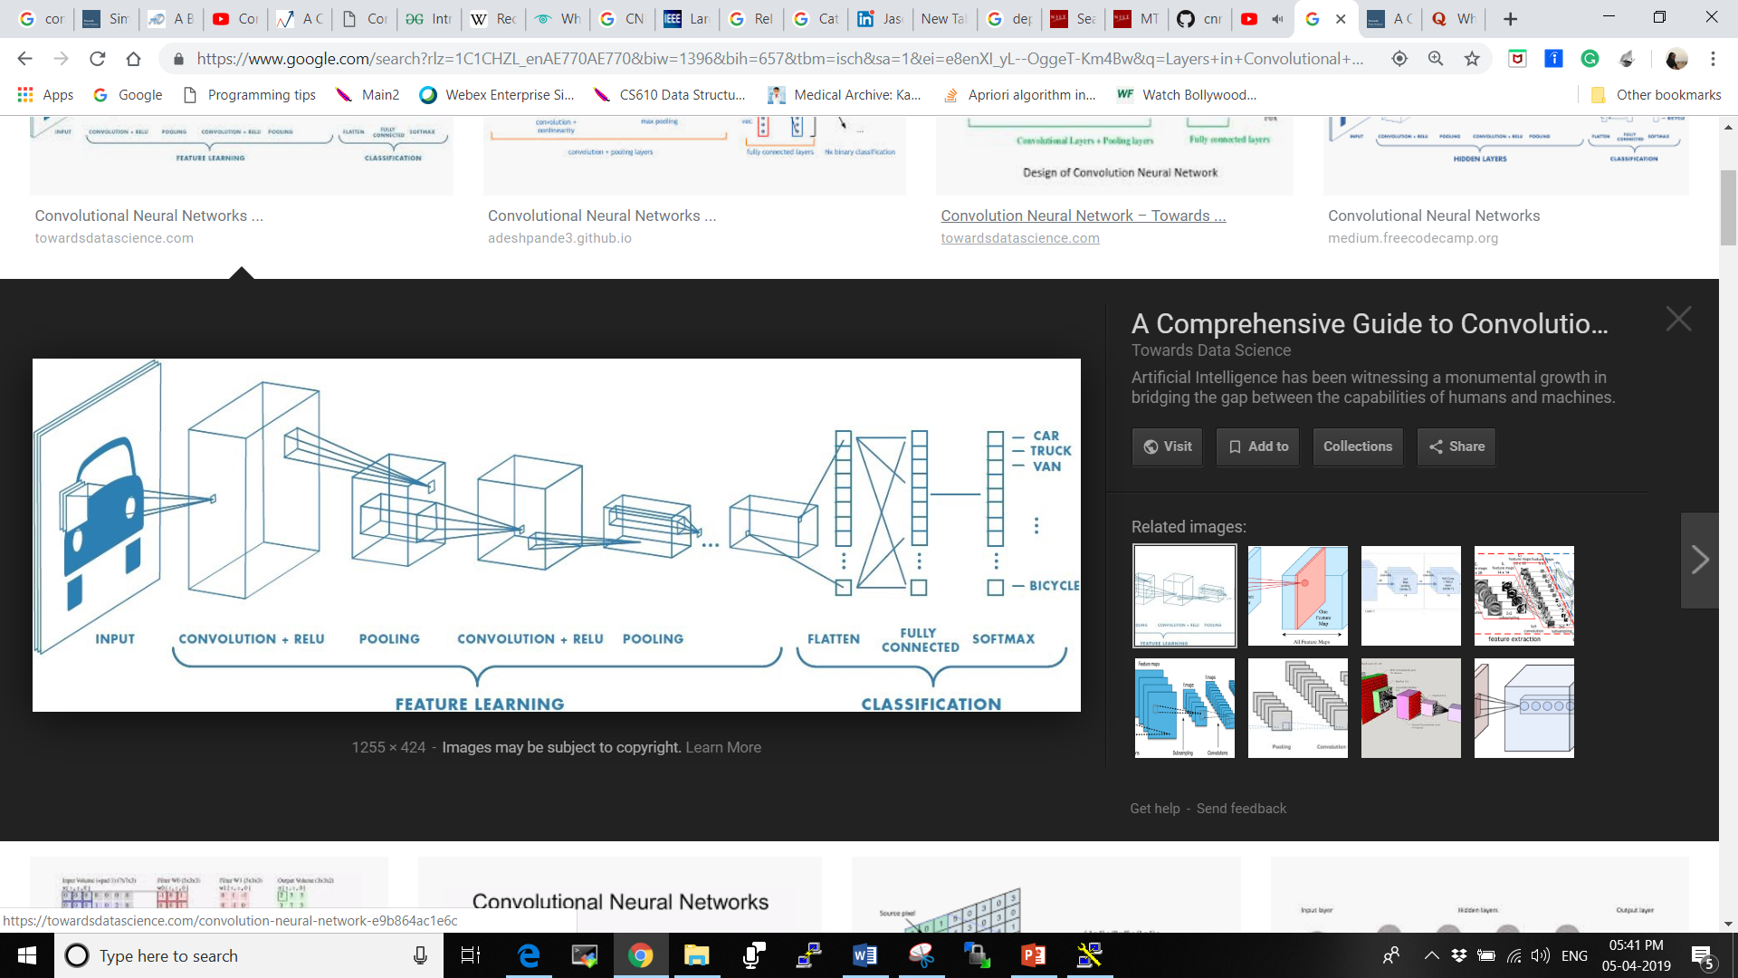
How Layers in Convolutional Neural Network Work ?

Slide 15
How Convolutional Layer works?
A convolutional layer has a number of filters that perform convolutional operations.
Once the feature maps are extracted next it is pass to ReL U Layer.
Example:
1 | 1 | 1 | 0 | 0
0 | 1 | 1 | 1 | 0
0 | 0 | 1 | 1 | 1
0 | 0 | 1 | 1 | 0
0 | 1 | 1 | 0 | 0
1 | 0 | 1
0 | 1 | 0
1 | 0 | 1
4 | 3 | 4
2 | 4 | 3
2 | 3 | 4
Filter
Image Pixels
Convolved Feature

Slide 16
How did we got Convolved Feature Matrix?
1 | 1 | 1 | 0 | 0
0 | 1 | 1 | 1 | 0
0 | 0 | 1 | 1 | 1
0 | 0 | 1 | 1 | 0
0 | 1 | 1 | 0 | 0
1 | 1 | 1
0 | 1 | 1
0 | 0 | 1
1 | 0 | 1
0 | 1 | 0
1 | 0 | 1
Insert values in new matrix by multiplying red matrix with 3x3 matric and then add the ones
1*1 | 0*1 | 1*1
0*0 | 1*1 | 0*1
1*0 | 0*0 | 1*1
1 | 0 | 1
0 | 1 | 0
0 | 0 | 1
*
Total number of 1’s = 4
1 | 1 | 0
1 | 1 | 1
0 | 1 | 1
1 | 1 | 1 | 0 | 0
0 | 1 | 1 | 1 | 0
0 | 0 | 1 | 1 | 1
0 | 0 | 1 | 1 | 0
0 | 1 | 1 | 0 | 0
1 | 0 | 1
0 | 1 | 0
1 | 0 | 1
1*1 | 1*0 | 0*1
1*0 | 1*1 | 1*0
0*1 | 1*0 | 1*1
1 | 0 | 0
0 | 1 | 0
0 | 0 | 1
Total number of 1’s = 4
*
4 | 3 | 4
2 | 4 | 3
2 | 3 | 4
Output Matrix :

Slide 17
Likewise the 3x3 matrix will rotate in 5x5 to generate 3x3 matrix.
1 | 1 | 1 | 0 | 0
0 | 1 | 1 | 1 | 0
0 | 0 | 1 | 1 | 1
0 | 0 | 1 | 1 | 0
0 | 1 | 1 | 0 | 0
1 | 0 | 0
1 | 1 | 0
1 | 1 | 1
1 | 1 | 1 | 0 | 0
0 | 1 | 1 | 1 | 0
0 | 0 | 1 | 1 | 1
0 | 0 | 1 | 1 | 0
0 | 1 | 1 | 0 | 0
1 | 1 | 1 | 0 | 0
0 | 1 | 1 | 1 | 0
0 | 0 | 1 | 1 | 1
0 | 0 | 1 | 1 | 0
0 | 1 | 1 | 0 | 0
1 | 1 | 1 | 0 | 0
0 | 1 | 1 | 1 | 0
0 | 0 | 1 | 1 | 1
0 | 0 | 1 | 1 | 0
0 | 1 | 1 | 0 | 0
1 | 0 | 0
1 | 1 | 0
1 | 1 | 1
1 | 0 | 0
1 | 1 | 0
1 | 1 | 1
1 | 0 | 0
1 | 1 | 0
1 | 1 | 1
1 | 1 | 1 | 0 | 0
0 | 1 | 1 | 1 | 0
0 | 0 | 1 | 1 | 1
0 | 0 | 1 | 1 | 0
0 | 1 | 1 | 0 | 0
1 | 1 | 1 | 0 | 0
0 | 1 | 1 | 1 | 0
0 | 0 | 1 | 1 | 1
0 | 0 | 1 | 1 | 0
0 | 1 | 1 | 0 | 0
1 | 1 | 1 | 0 | 0
0 | 1 | 1 | 1 | 0
0 | 0 | 1 | 1 | 1
0 | 0 | 1 | 1 | 0
0 | 1 | 1 | 0 | 0
4 | 3 | 4
2 | 4 | 3
2 | 3 | 4
1 | 0 | 0
1 | 1 | 0
1 | 1 | 1
1 | 0 | 0
1 | 1 | 0
1 | 1 | 1
1 | 0 | 0
1 | 1 | 0
1 | 1 | 1
Final Output

Slide 18
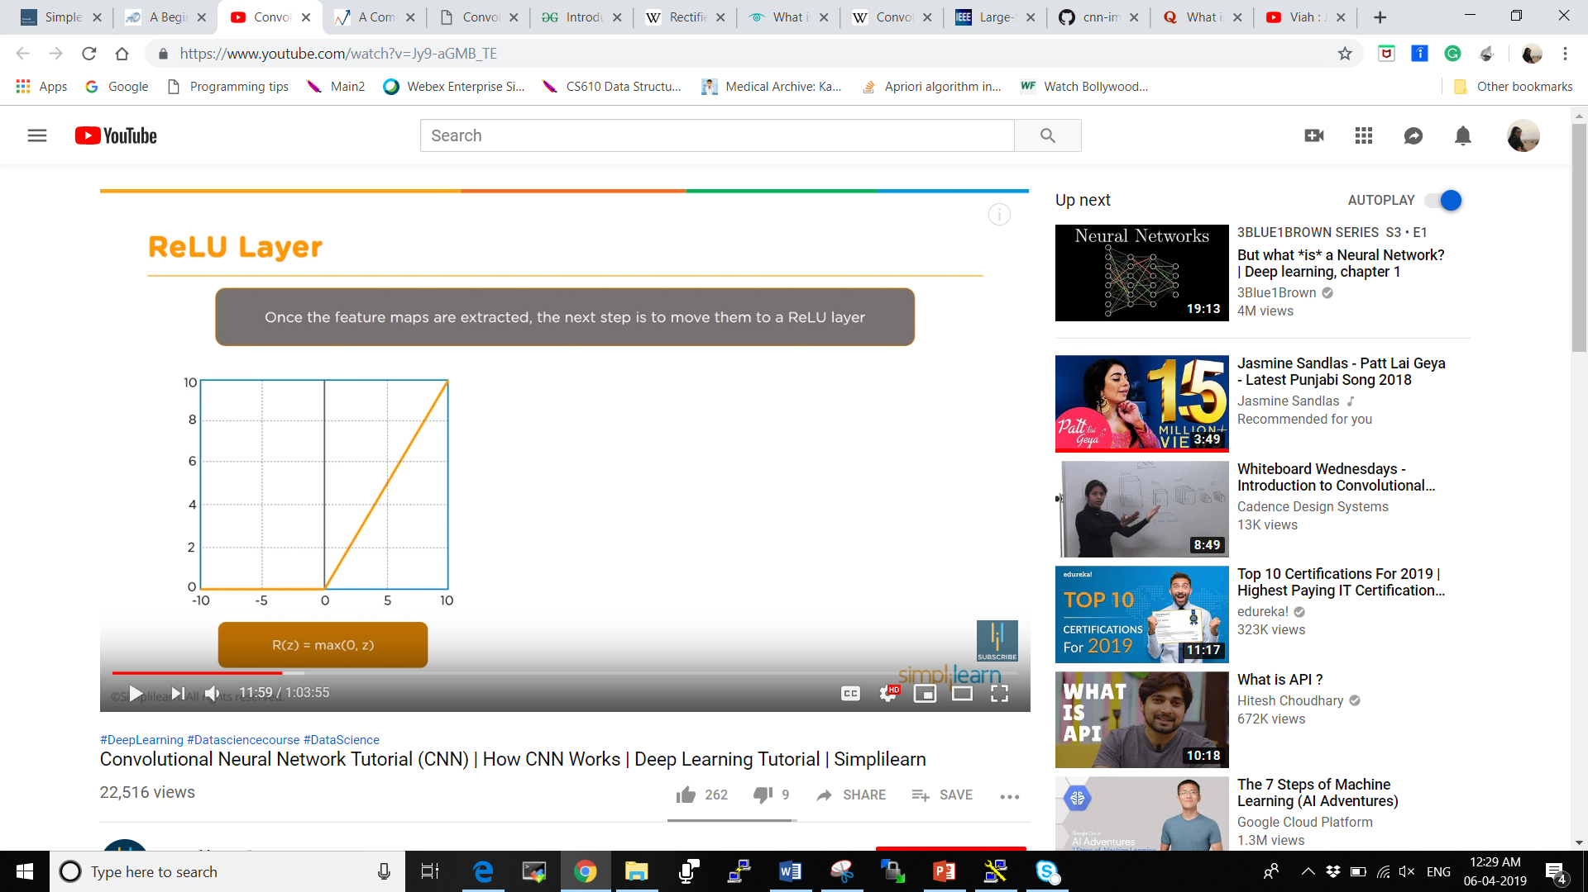
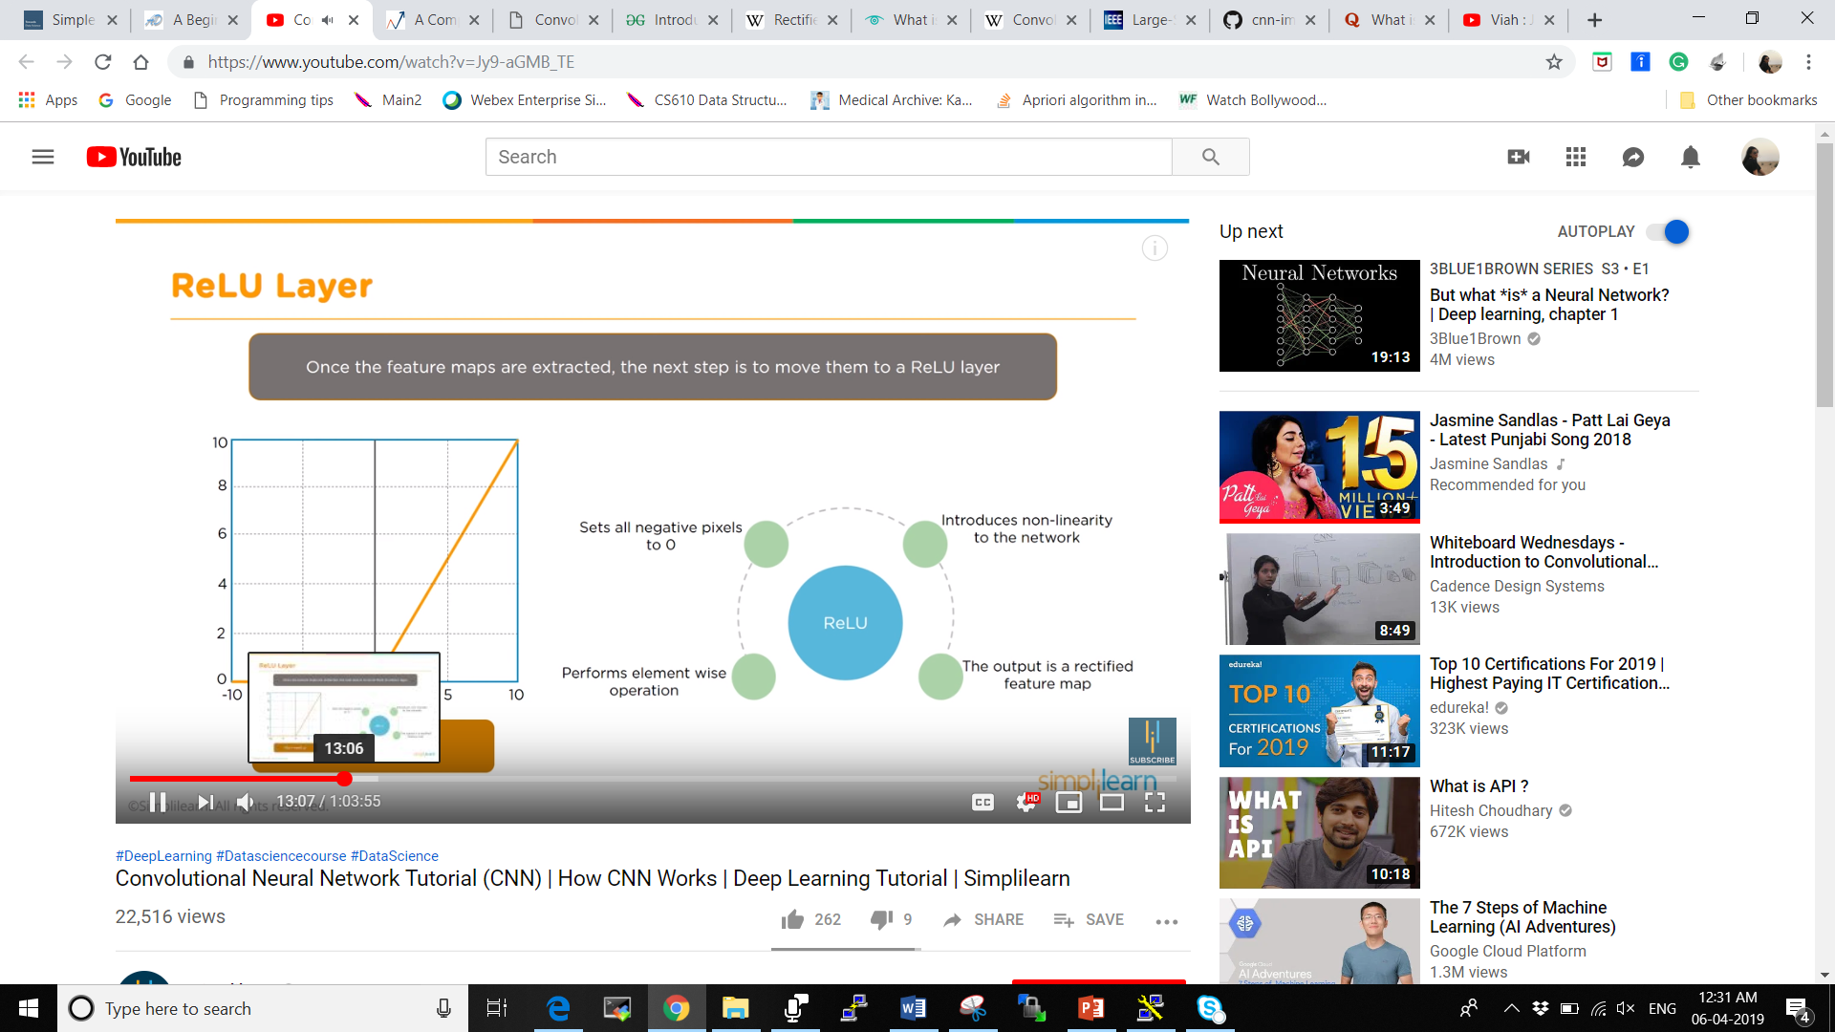
How ReL U Layer works?
In ReL U step first is going to perform an element wise operation s
In each of these mapping coming in if there is a negative prixels it sets all the negative pixels to 0.
Introduces non linearity to the network.
The output is a rectified feature map in which features are coming through and how they weigh from the filters.
We don’t run just one filter but number for filters on the image.

Slide 19
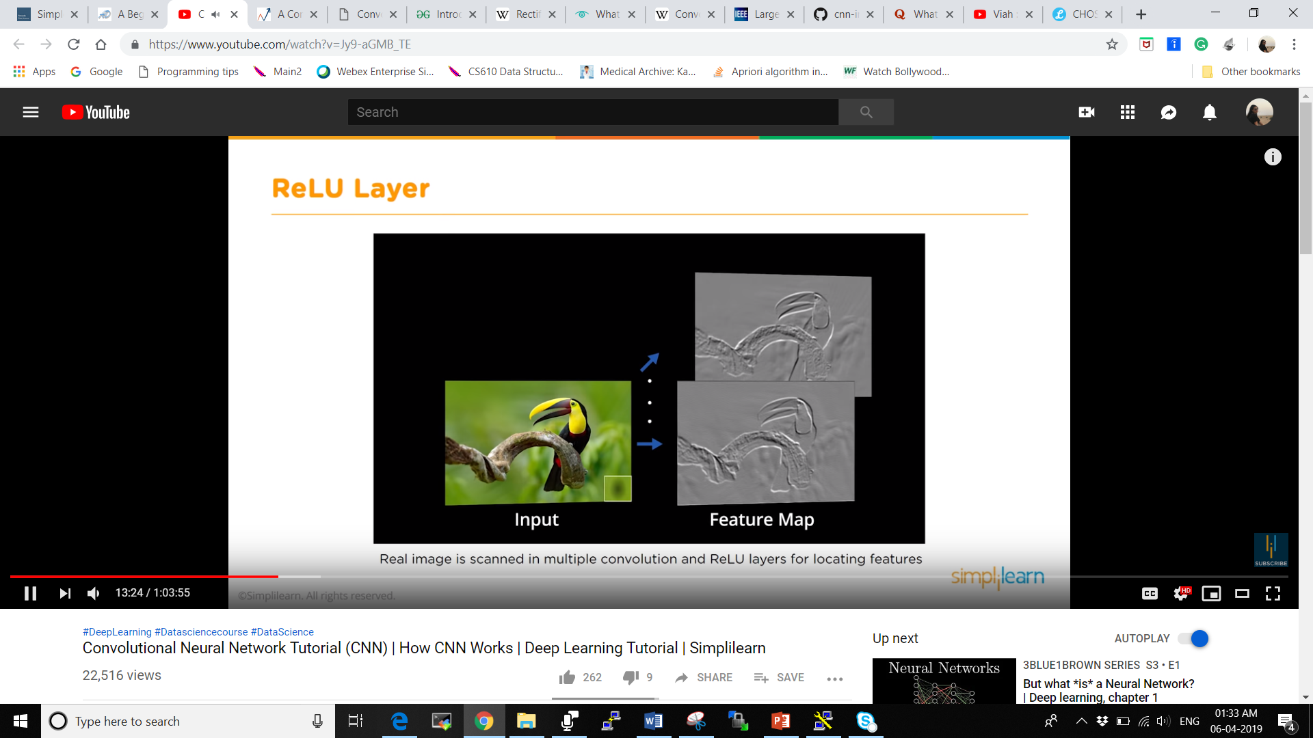
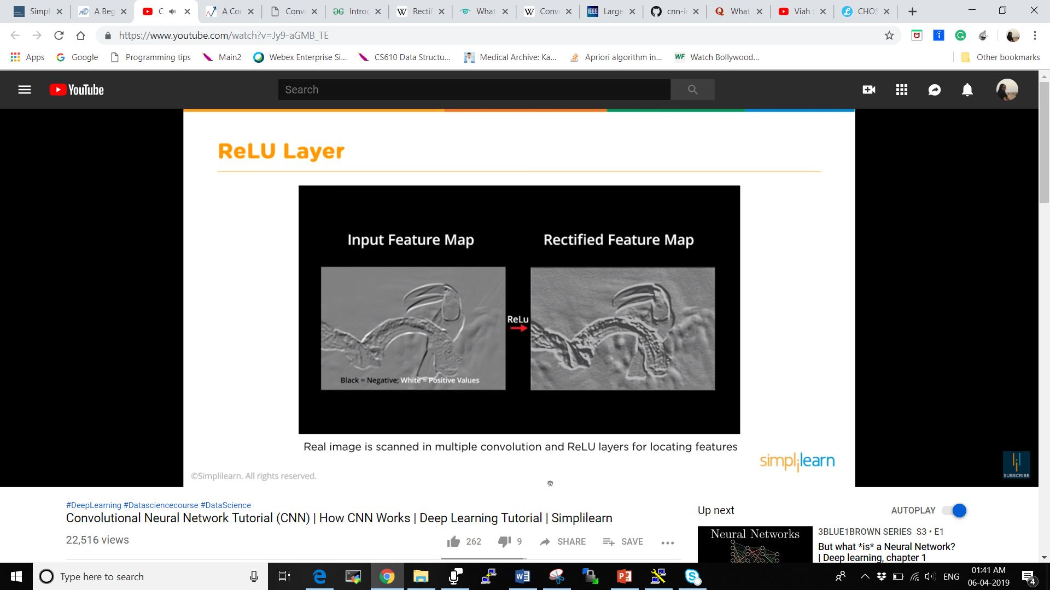
How ReL U Layer works?
Real image is scanned in multiple convolution and ReL U layers for locating features.
We are not having just one ReL U layer but multiple features and multiple ReL U to get multiple layers.

Slide 20
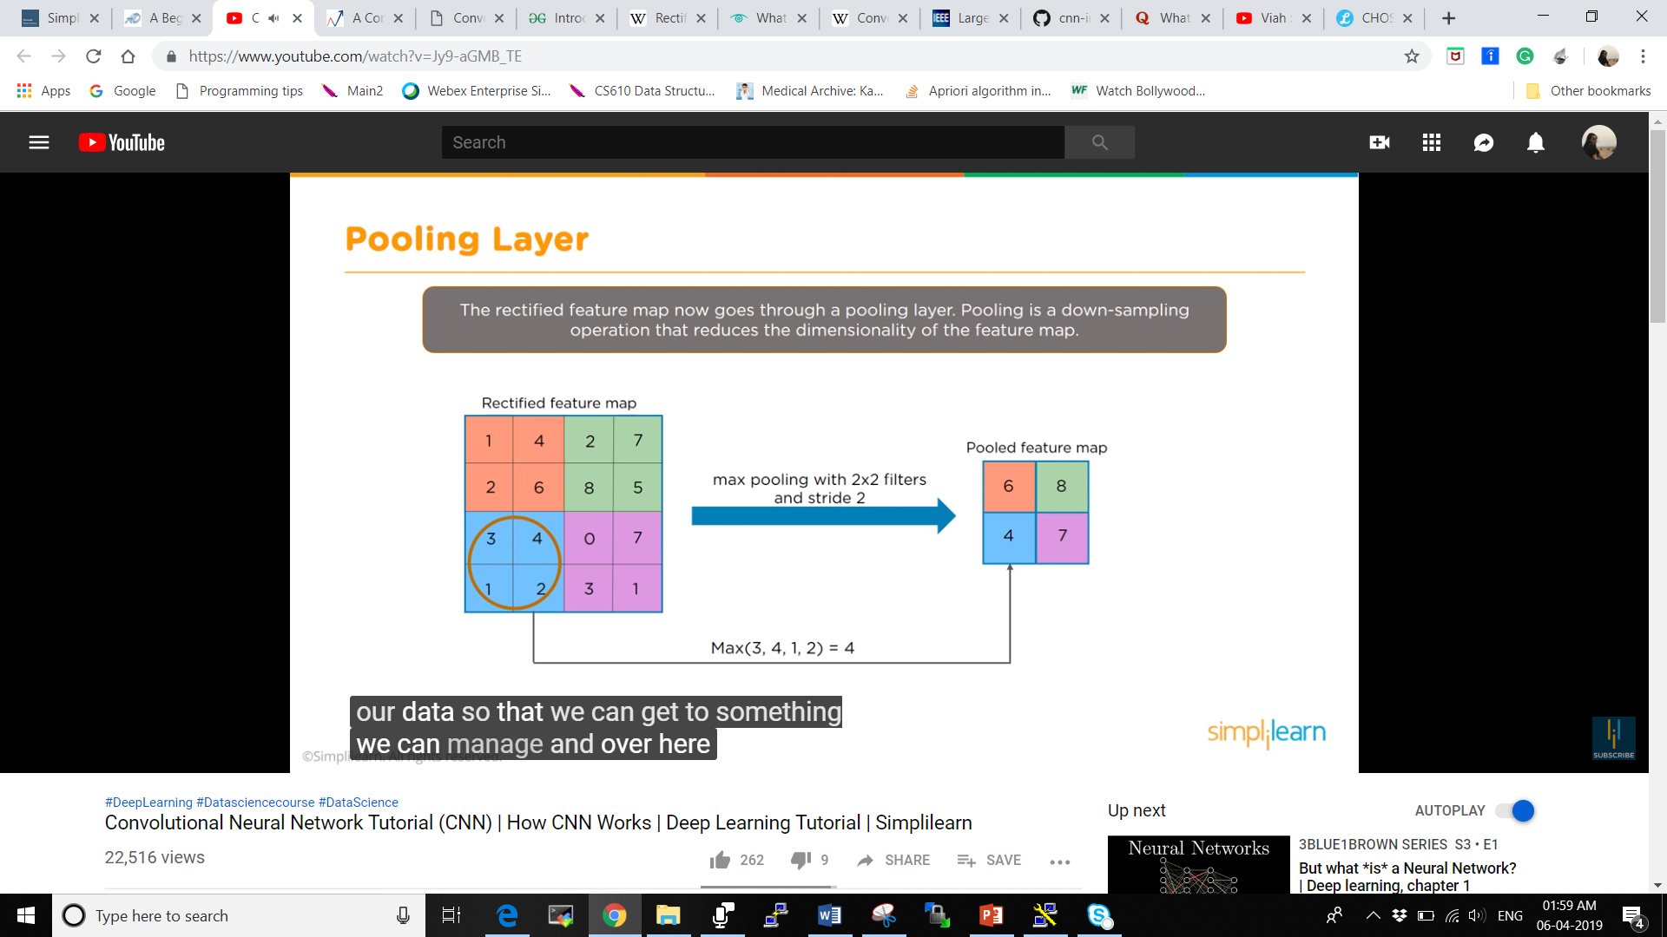
How Pooling Layer works?
The rectified image in ReL U now goes under Pooling Layer. Pooling is a down – sampling operation that reduces the dimensionality of the feature map.
Coming from rectified value we find the max value then we’re pooling those features together And what matter is how much feature value do we just want to find the best or the maximum feature for that area they might have that one piece of the filter.

Slide 21
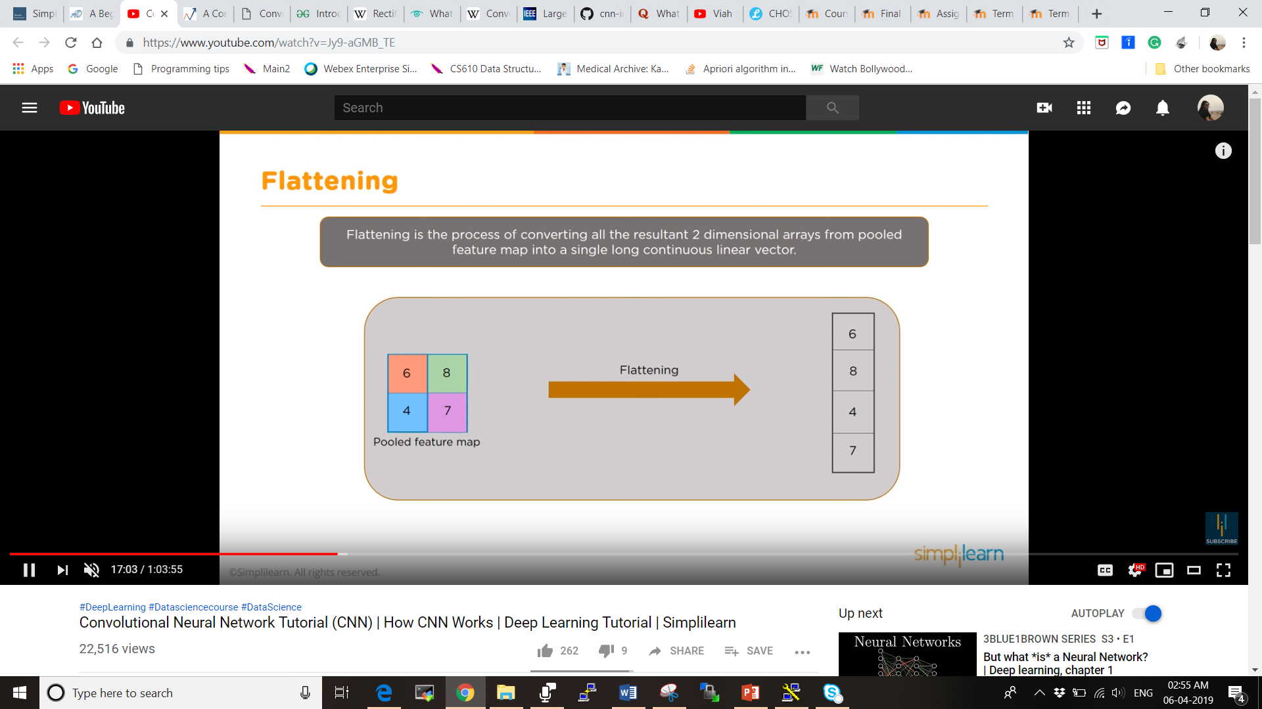
Flattening
Flattening is the process of converting all the resultant 2 dimensional arrays from pooled feature map into a single long continuous linear vector.

Slide 22
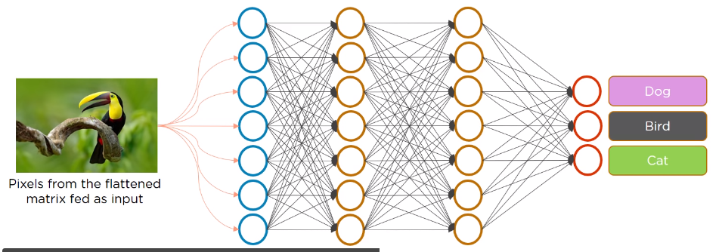
Full Connected Layer
The Flattened matrix from the pooling layer is fed as input to the fully connected layer to classify the image.
We have the pixels from flattened matrix fed as an input back to the full connected layer. Then it comes to the forward propogation network and then we have different weights coming down across and then we finally selects what that image is and rejects the other options.

Slide 23
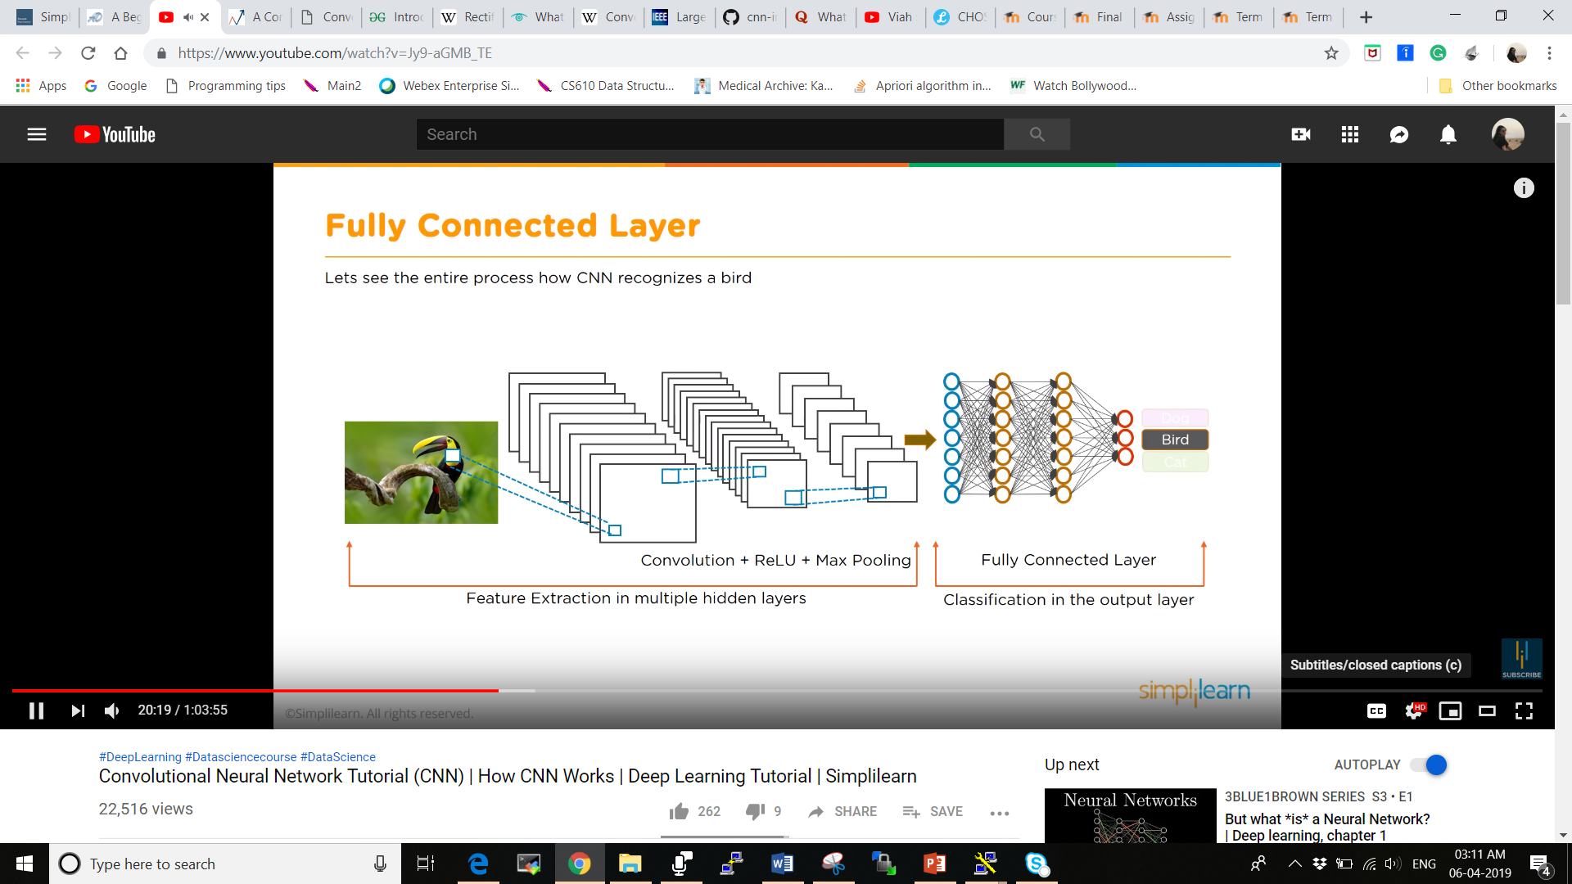
Summary for Image Recognition
We took the input image which is twisted and filtered it, multiplied the matrix where we ended up in the convolutional layer.
Which further uses ReL U to figure out the values going out in the pool as you have numerous convolutional layers.
Further it creates numerous pooling layers where we pool that data together which is the max value which we want to send forward.
We will send the best value and from pooling layer we are going to flatten it and we’re going to combine them into the single input that is going into the final layer that is fully connected layer at the end.

Slide 24
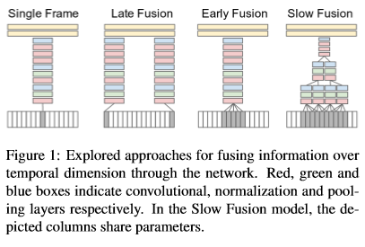
Video Recognition
Unlike images which can be cropped and rescaled to a ﬁxed size, videos vary widely in temporal extent and cannot be easily processed with a ﬁxed-sized architecture
Since each clip contains several contiguous frames in time, we can extend the connectivity of the network in time dimension to learn spatio-temporal features.
There are multiple options for the precise details of the extended connectivity and we describe three broad connectivity pattern categories like Early Fusion, Late Fusion and Slow Fusion.
Afterwards, we describe a multiresolution architecture for addressing the computational efﬁciency.

Slide 25
Time Information Fusion in CNNs The fusion can be done early in the network by modifying the ﬁrst layer convolutional ﬁlters to extend in time, or it can be done late by placing two separate single-frame networks some distance in time apart and fusing their outputs later in the processing. Single-Frame Early Fusion Late Fusion Slow Fusion

Slide 26
a. Single Frame
We use a single-frame baseline architecture to understand the contribution of static appearance to the classiﬁcation accuracy.
This network is similar to the ImageNet challenge winning model [11], but accepts inputs of size 170 × 170 × 3 pixels instead of the original 224×224×3. Using shorthand notation, the full architecture is C(96,11,3)-N-P-C(256,5,1)-N-P-C(384,3,1)C(384,3,1)-C(256,3,1)-P-FC(4096)-FC(4096), where C(d,f,s) indicates a convolutional layer with d ﬁlters of spatial size f×f, applied to the input with stride s. FC(n) is a fully connected layer with n nodes. All pooling layers P pool spatially in non-overlapping 2×2 regions and all normalization layers N are deﬁned as described in Krizhevsky et al. [11] and use the same parameters: k = 2,n = 5,α = 10−4,β = 0.5. The ﬁnal layer is connected to a softmax classiﬁer with dense connections.

Slide 27
b. Early Fusion
It combines information across an entire time window immediately on the pixel level.
This is implemented by modifying the ﬁlters on the ﬁrst convolutional layer in the single-frame model by extending them to be of size 11×11×3×T pixels, where T is some temporal extent (we use T = 10, or approximately a third of a second). The early and direct connectivity to pixel data allows the network to precisely detect local motion direction and speed.

Slide 28
c. Late Fusion
The Late Fusion model places two separate single-frame networks, up to last convolutional layer C(256,3,1) with shared parameters a distance of 15 frames apart and then merges the two streams in the ﬁrst fully connected layer.
Therefore, neither single frame tower alone can detect any motion, but the ﬁrst fully connected layer can compute global motion characteristics by comparing outputs of both towers.

Slide 29
d. Slow Fusion
The Slow Fusion model is a balanced mix between the two approaches that slowly fuses temporal information throughout the network such that higher layers get access to progressively more global information in both spatial and temporal dimensions.
This is implemented by extending the connectivity of all convolutional layers in time and carrying out temporal convolutions in addition to spatial convolutions to compute activations.
In the model we use, the ﬁrst convolutional layer is extended to apply every ﬁlter of temporal extent T = 4 on an input clip of 10 frames through valid convolution with stride 2 and produces 4 responses in time.
The second and third layers above iterate this process with ﬁlters of temporal extent T = 2 and stride 2. Thus, the third convolutional layer has access to information across all 10 input frames.

Slide 30
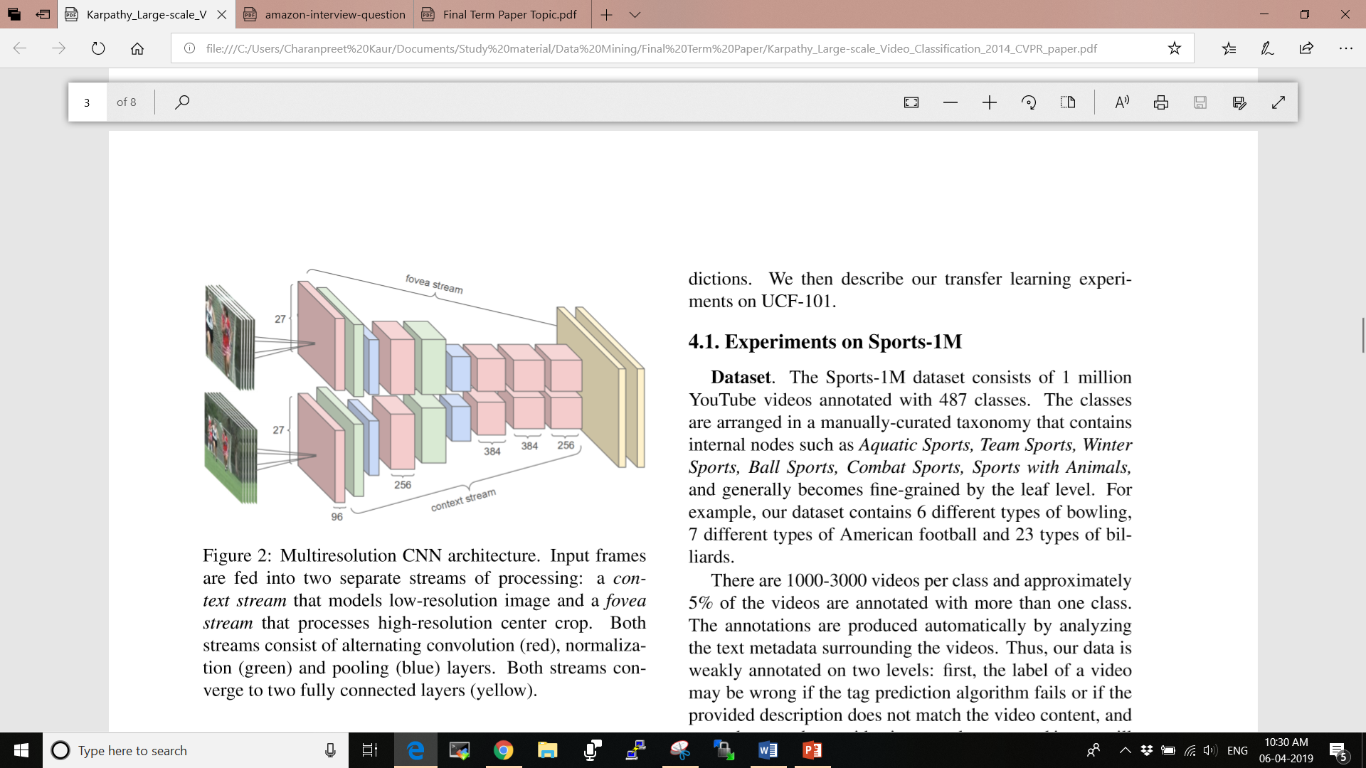
Multiresolution CNN Architecture
Since CNNs normally take on orders of weeks to train on large-scale datasets even on the fastest available GPUs, the runtime performance is a critical component to our ability to experiment with different architecture and hyperparameter settings.
This motivates approaches for speeding up the models while still retaining their performance.

Slide 31
Experiments on Sports- 1M
The Slow Fusion model is a balanced mix between the two approaches that slowly fuses temporal information throughout the network such that higher layers get access to progressively more global information in both spatial and temporal dimensions.
This is implemented by extending the connectivity of all convolutional layers in time and carrying out temporal convolutions in addition to spatial convolutions to compute activations.
In the model we use, the ﬁrst convolutional layer is extended to apply every ﬁlter of temporal extent T = 4 on an input clip of 10 frames through valid convolution with stride 2 and produces 4 responses in time.
The second and third layers above iterate this process with ﬁlters of temporal extent T = 2 and stride 2. Thus, the third convolutional layer has access to information across all 10 input frames.

Slide 32
Datasets:
The Sports-1M dataset consists of 1 million YouTube videos annotated with 487 classes.
Our dataset contains 6 different types of bowling, 7 different types of American football and 23 types of billiards.
There are1000-3000 videos per class and approximately 5% of the videos are annotated with more than one class. The annotations are produced automatically by analysing the text metadata surrounding the videos.
Our data is weakly annotated on two levels :
First, the label of a video may be wrong if the tag prediction algorithm fails or if the provided description does not match the video content.
Even when a video is correctly annotated it may still exhibit signiﬁcant variation on the frame level.

Slide 33
Datasets:
Split the dataset by assigning 70% of the videos to the training set, 10% to a validation set and 20% to a test set.
To get an idea about the duplicate video all videos are processed with a near-duplicate ﬁnding algorithm on the frame level and determined that only1755 videos (out of 1 million) contain a signiﬁcant fraction of near-duplicate frames.
Videos are 5 minutes and 36 seconds in length on average, it is unlikely that the same frames occur across data splits.

Slide 34
Training
Models were trained over a period of one month, with models processing approximately 5 clips per second for full-frame networks and up to 20 clips per second for multiresolution networks on a single model replica.
The rate of 5 clips per second is roughly 20 times slower than what one could expect from a high-end GPU, but it was expected to reach comparable speeds over all given that used 10-50 model replicas.
Further estimated the size of our dataset of sampled frames to be on the order of 50 million examples and that our networks have each seen approximately 500 million examples throughout the training period in total.

Slide 35
Video Level Predictions
To produce predictions for an entire video, randomly sample 20 clips and present each clip individually to the network.
Every clip is propagated through the network 4 times and the network class predictions are averaged to produced more robust estimate of the class probabilities.
To produce video-level predictions the simplest approach was opted of averaging individual clip predictions over the durations of each video. More elaborated techniques to further improve performance were expected but consider these to be outside of the scope of the paper.

Slide 36
Feature Histogram Baselines
The accuracy of a feature-based approach was reported by extracting several types of features at all frames of our videos, discretize them using k-means vector quantization and accumulate words into histograms with spatial pyramid encoding and soft quantization.
Every histogram is normalized to sum to 1 and all histograms are concatenated into a 25,000 dimensional video-level feature vector.
As a classiﬁer we use a multilayer neural network with Rectiﬁed Linear Units followed by a Softmax classiﬁer.
We found that a multilayer network performs consistently and signiﬁcantly better than linear models on separate validation experiments.

Slide 37
Feature Histogram Baselines
Extensive cross validations were performed across many of the network’s hyperparameters by training multiple models and choosing the one with best performance on a validation set.
The tuned hyper parameters include the learning rate, weight decay, the number of hidden layers (between 1-2), dropout probabilities and number of nodes in all layers.

Slide 38
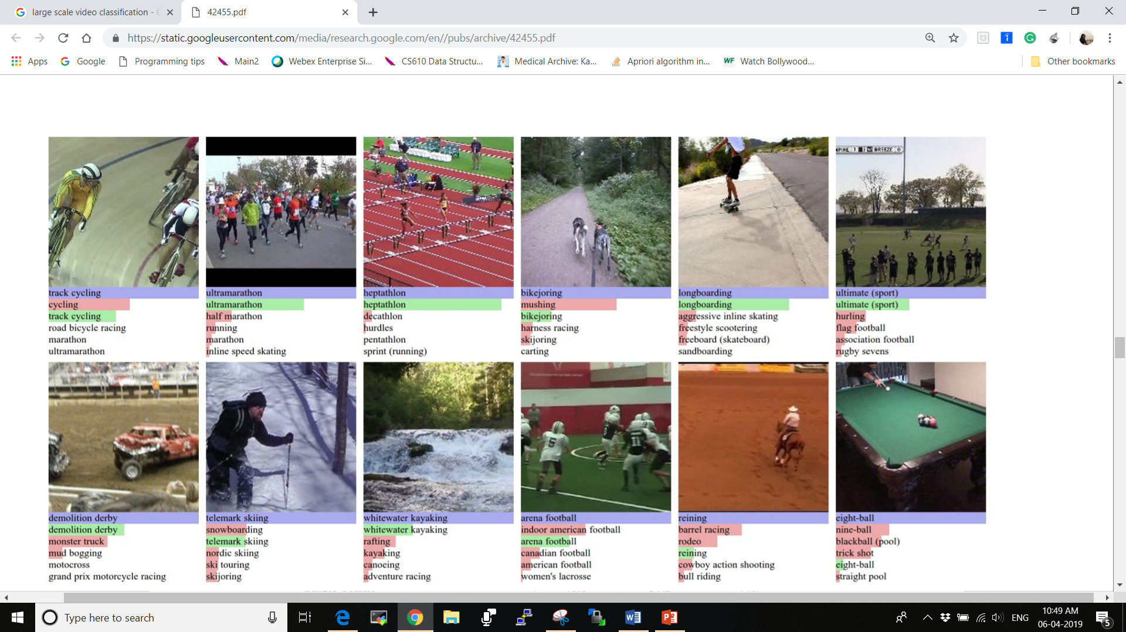
Quantitative Analysis
Predictions on Sports-1M test data.
Blue (first row) indicates ground truth label.
The bars below show model predictions sorted in decreasing confidence.
Green and red distinguish correct and incorrect predictions, respectively

Slide 39
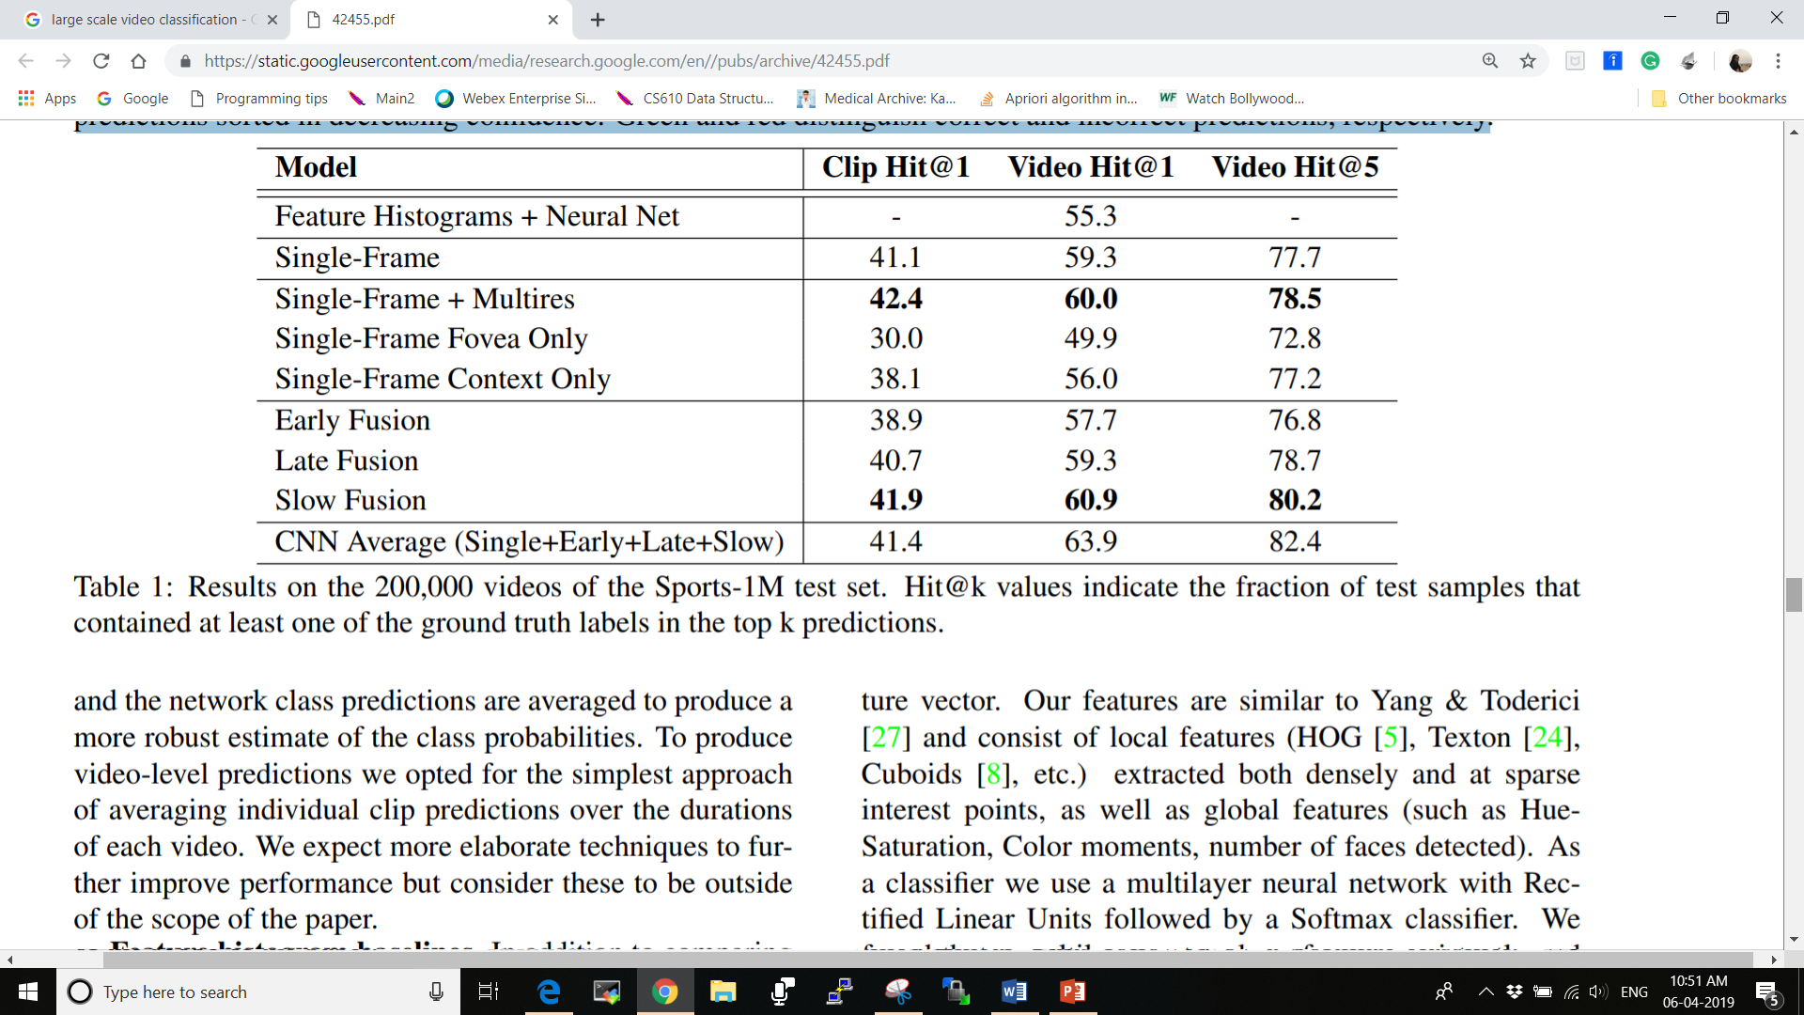
Quantitative Analysis

Slide 40
Quantitative Analysis
As can be seen from the table, networks consistently and significantly outperform the feature-based baseline.
It emphasize that the feature-based approach computes visual words densely over the duration of the video and produces predictions based on the entire video-level feature vector, while our networks only see 20 randomly sampled clips individually.
Moreover, networks seem to learn well despite signiﬁcant label noise: the training videos are subject to incorrect annotations and even the correctly labeled videos often contain a large amount of artifacts such as text, effects, cuts, and logos, none of which we attempted to ﬁlter out explicitly.

Slide 41
Quantitative Analysis
Compared to the wide gap relative to the feature-based baseline, the variation among different CNN architectures turns out to be surprisingly insigniﬁcant.
Notably, the single-frame model already displays strong performance. Furthermore, it was observed that the foveated architectures are between 2-4 × faster in practice due to reduced input dimensionality.
The precise speedups are in part a function of the details of model partitioning and our implementation ,but in our experiments we observe a speedup during training of 6 to21clipspersecond(3.5x)for the single-frame model and 5 to 10 clips per second (2x) for the Slow Fusion model.

Slide 42
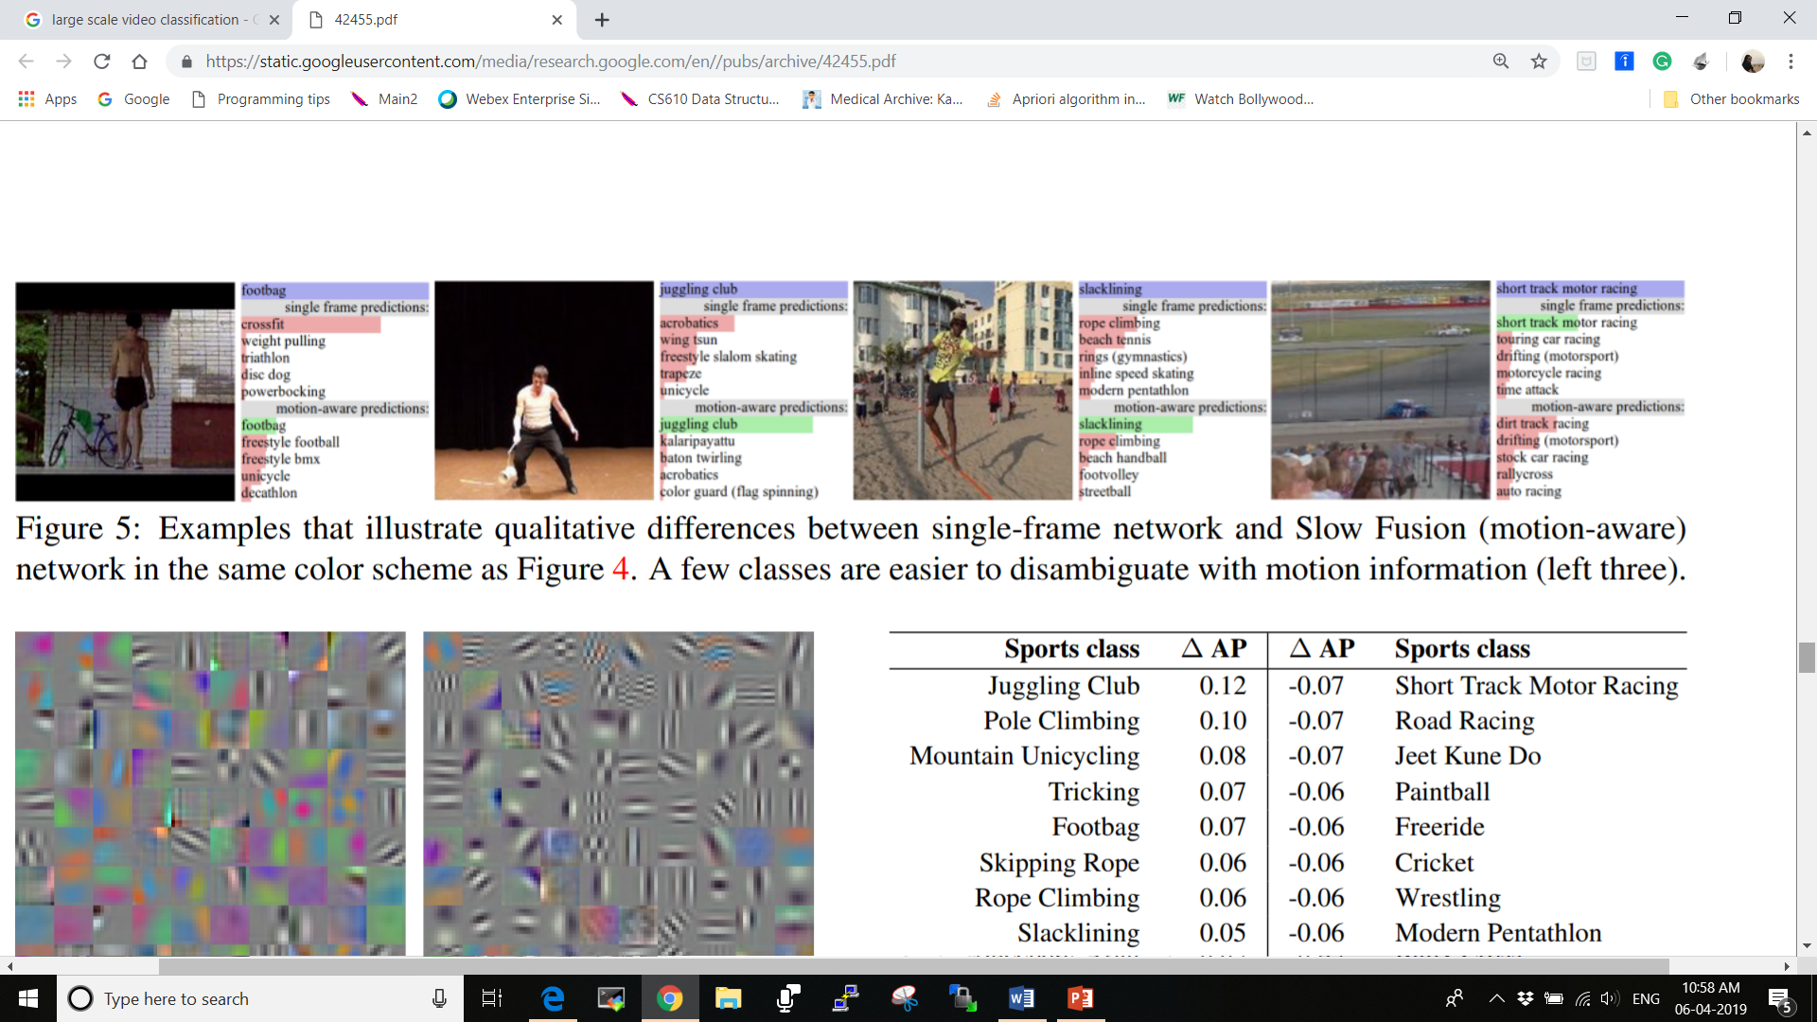
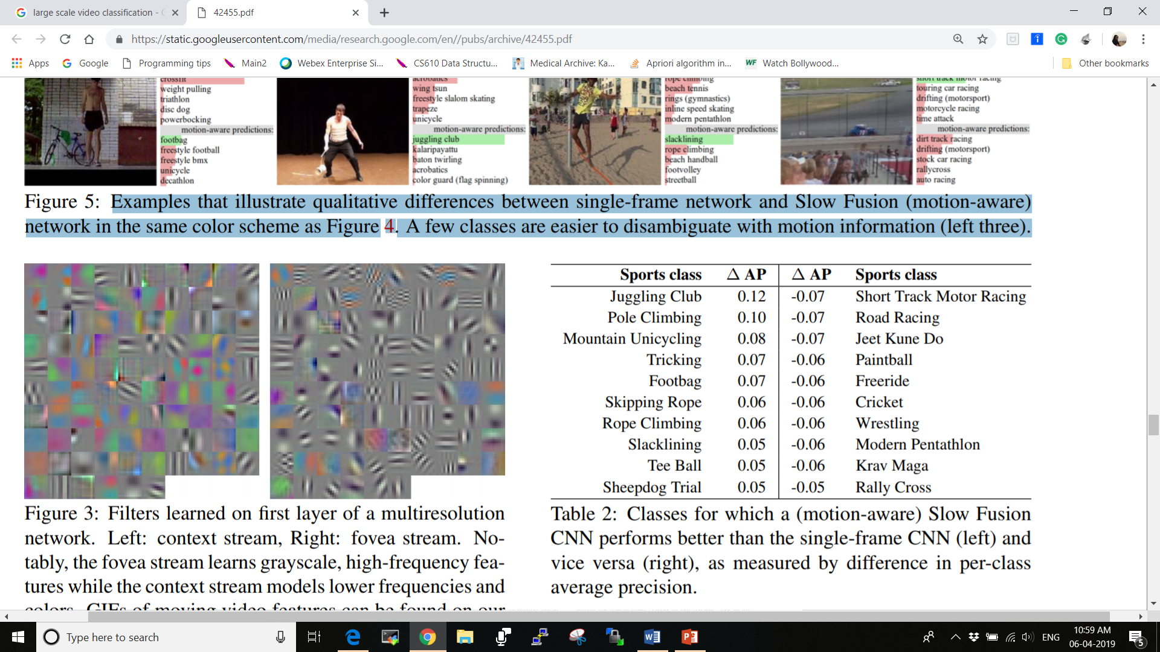
Contribution of Motions
Examples that illustrate qualitative differences between single-frame network and Slow Fusion (motion-aware) network in the same color scheme as in above figure. A few classes are easier to disambiguate with motion information (left three).

Slide 43
Contribution of Motions
Further experiments were conducted to understand the differences between the single frame network and networks that have access to motion information.
We choose the Slow Fusion network as a representative motion-aware network because it performs best. We compute and compare the per-class average precision for all Sports classes and highlight the ones that exhibit largest differences as shown in Table 2.
Manually inspecting some of the associated clips in the figure, we qualitatively observe that the motion-aware network clearly benefits from motion information in some cases, but these seem to be relatively uncommon.

Slide 44
Contribution of Motions
On the other hand, balancing the improvements from access to motion information, we observe that motion aware networks are more likely to underperform when there is camera motion present.
We hypothesize that the CNNs struggle to learn complete invariance across all possible angles and speeds of camera translation and zoom.

Slide 45
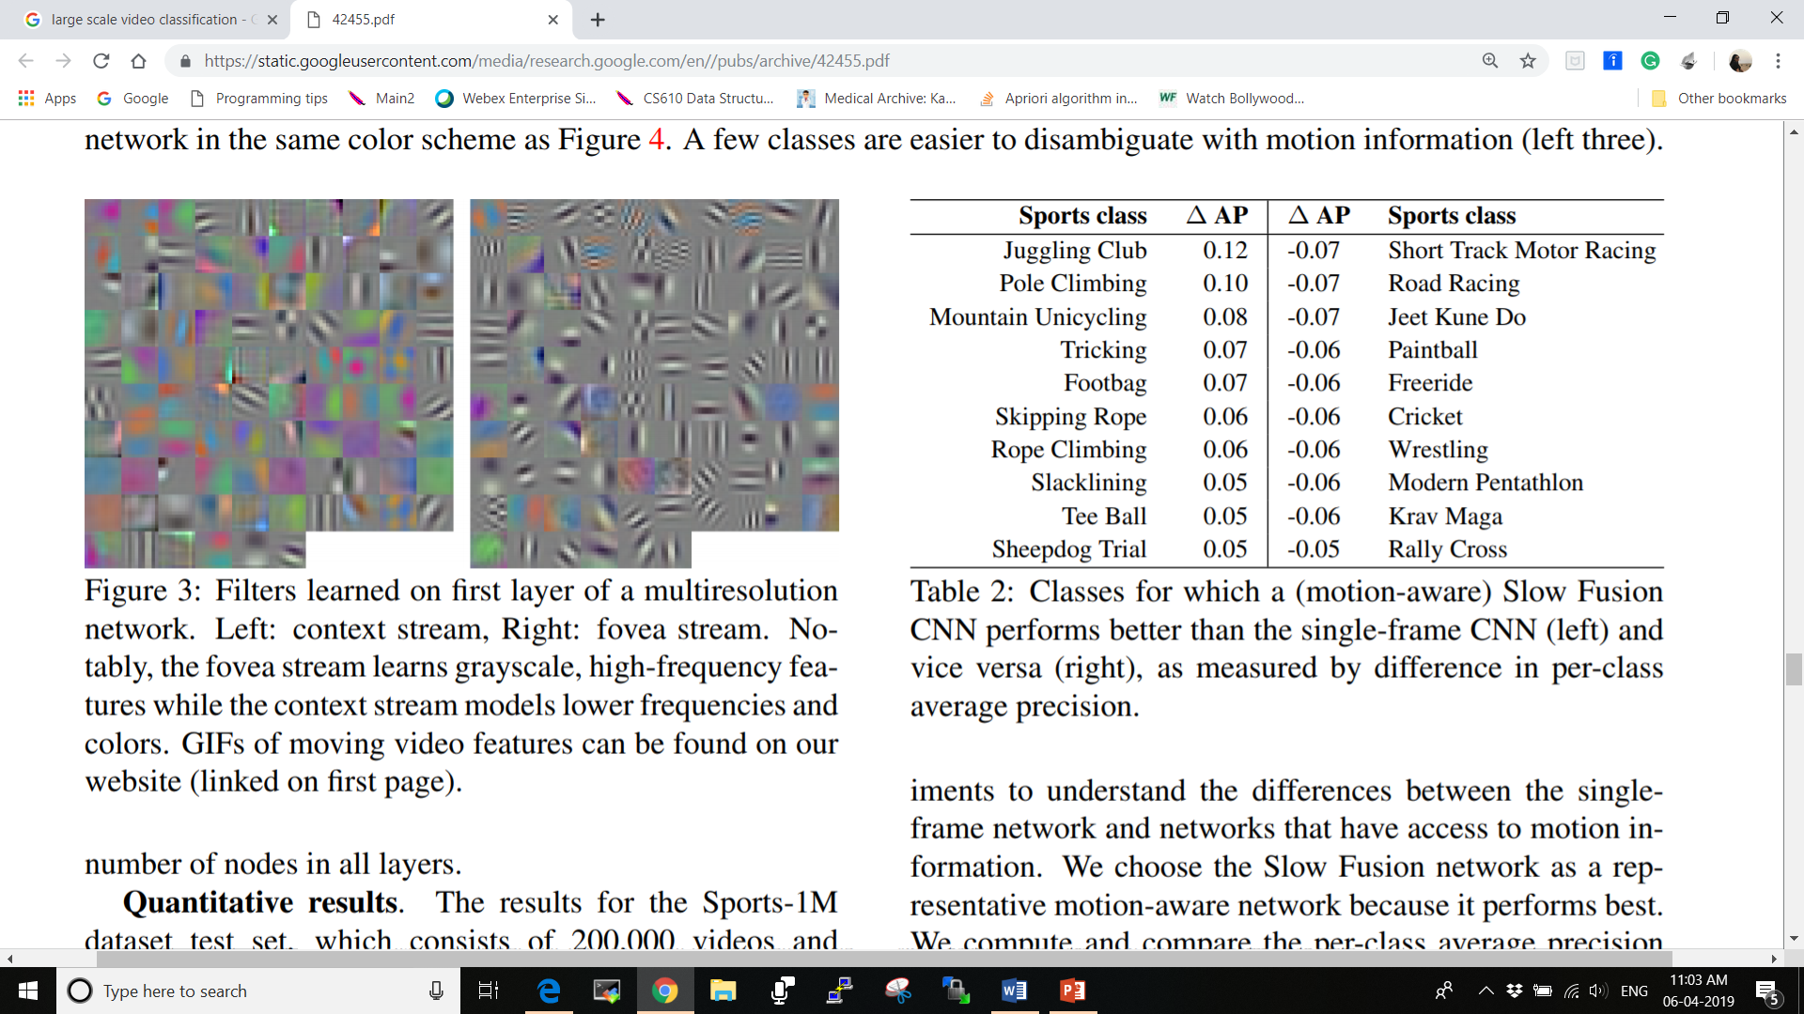
Qualitative Analysis
Our learned features for the first convolutional layer can be inspected on Figure below.
Interestingly, the context stream learns more color features while the high-resolution fovea stream learns high frequency grayscale filters.
As can be seen on very first figure, networks produced interpretable predictions and generally make reasonable mistakes.
Further analysis of the confusion matrix reveals that most errors are among the fine-grained classes of our dataset. For example, the top 5 most commonly confused pairs of classes are deer hunting vs. hunting, hiking vs. backpacking, powered paragliding vs. paragliding, sledding vs. toboggan, and bujinkan vs. ninjutsu.
Filters learned on first layer of a multiresolution network. Left: context stream, Right: fovea stream. Notably, the fovea stream learns grayscale, high-frequency features while the context stream models lower frequencies and colors.

Slide 46
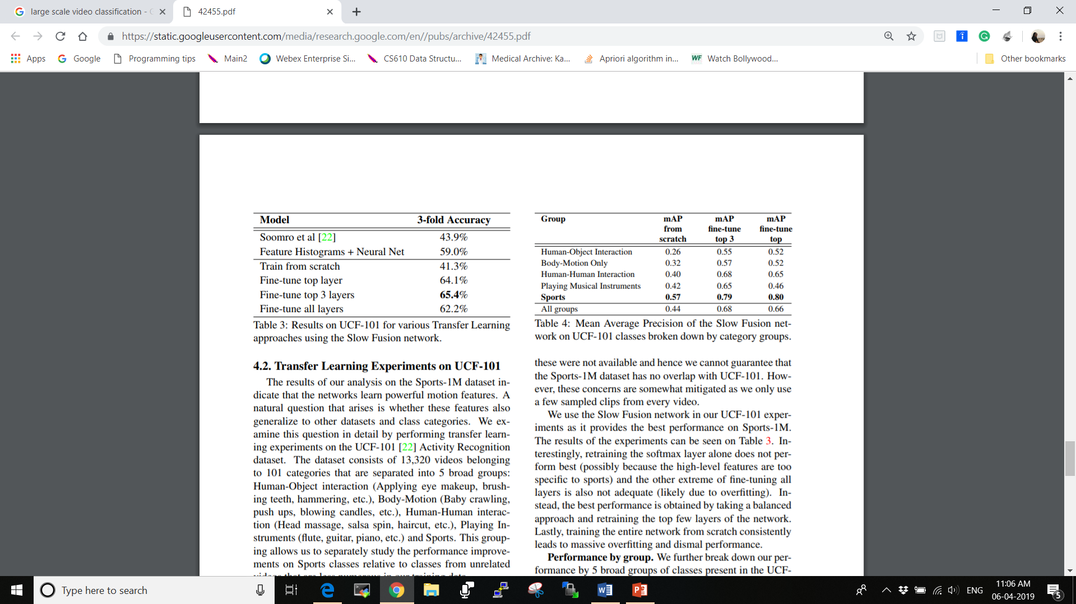
Result
Mean Average Precision of the Slow Fusion network on UCF-101 classes broken down by category groups.
Results on UCF-101 for various Transfer Learning approaches using the Slow Fusion network.

Slide 47
Conclusion
We studied the performance of convolutional neural networks in large-scale video classification. We found that CNN architectures are capable of learning powerful features from weakly-labeled data that far surpass feature based methods in performance and that these benefits are surprisingly robust to details of the connectivity of the architectures in time.
Qualitative examination of network outputs and confusion matrices reveals interpretable errors. Our results indicate that while the performance is not particularly sensitive to the architectural details of the connectivity in time, a Slow Fusion model consistently performs better than the early and late fusion alternatives.

Slide 48
Conclusion
Surprisingly, we find that a single-frame model already displays very strong performance, suggesting that local motion cues may not be critically important, even for a dynamic dataset such as Sports. An alternative theory is that more careful treatment of camera motion may be necessary, but this requires significant changes to a CNN architecture that we leave for future work.
We also identified mixed-resolution architectures that consist of a low-resolution context and a high resolution fovea stream as an effective way of speeding up CNNs without sacrificing accuracy. Our transfer learning experiments on UCF-101 suggest that the learned features are generic and generalize other video classification tasks. In particular, we achieved the highest transfer learning performance by retraining the top 3 layers of the network.

Slide 49
References
https://static.googleusercontent.com/media/research.google.com/en//pubs/archive/42455.pdf
https://adeshpande3.github.io/A-Beginner%27s-Guide-To-Understanding-Convolutional-Neural-Networks/
https://www.youtube.com/watch?v=Jy9-aGMB_TE
https://searchenterpriseai.techtarget.com/definition/convolutional-neural-network
https://ieeexplore.ieee.org/abstract/document/6909619
https://adeshpande3.github.io/A-Beginner%27s-Guide-To-Understanding-Convolutional-Neural-Networks/

